Slide 1
Snake+
Professor: Hao Xu
Adriano Tavares
Date: 06/04/2018

Slide 2
1
Contents:
2
Introduction
4
3
Analysis
Implementation
5
Design
6
Testing
Result
Conclusion

Slide 3
1
Introduction
Problem Statement:
Compile the classic game--Snake using C language,and add some new ideas to the game(that's why we call it snake+).
Goals:
1.Finish the basic functions: creating food, pressing arrow keys to control the snake, eating food to get more scores , optimizing the player experience,etc.
2.Make multiple modes based on the basic functions: double mode, infinite mode,moving-obstacle mode.
1
2
3
4
5
6

Slide 4
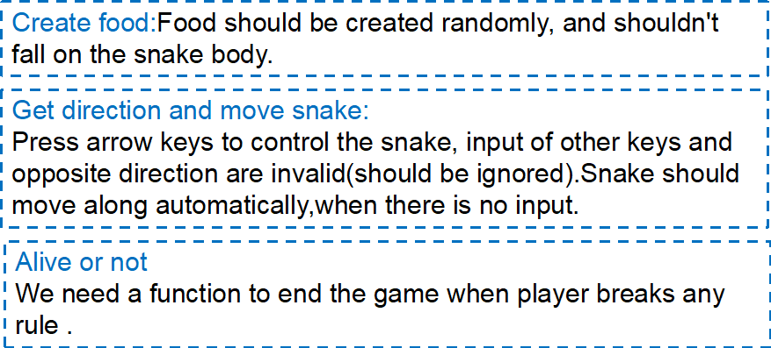
2
Analysis
--Basic functions
1
2
3
4
5
6

Slide 5
2
Analysis
--Basic functions
Single Mode
Rules:
1.Press the arrow keys to control the movement of the snake.
2.Press space key to pause and continue.
3.Press F1 to speed up and F2 to slow down.
4.Press ESC to exit and save data,you can choose whether to continue when enter the game next time.
1
2
3
4
5
6

Slide 6
2
Analysis--Multiple modes
Double Mode
Direction input of two players need to be received, so firstly, we should judge the current input is from which player. To be fair,the player who break the rules first should be punished.
Rules:
1.Press arrow keys or a/w/s/d keys to control the movement of two snakes.
2.Two snakes eat different food.
3.Eat opponent's food ,score minus 1 and snake will become shorter.
4.If one player run into the wall/eat itself/bump the opponent,game over,score will minus 5.
5.The one who gets a higher score in a certain time is winner
1
2
3
4
5
6

Slide 7
2
Analysis
--Multiple modes
Infinite Mode
If player breaks the rules,a new snake with the same length should be created. The map should be printed again. To set the time for players to react, it can’t be created close to the wall. We think no upper speed limit is OK because we can set a function for player to adjust to the most comfort speed at any time.Player can exit by pressing ESC.
1
2
3
4
5
6

Slide 8
2
Analysis
--Multiple modes
Moving-obstacle Mode
As we want to achieve the function that every time the player gets some more scores, a new obstacle will be created,we also need a linked list to record the obstacles. They shouldn't go out of the map while moving automatically.
If snake meets an obstacle, score minus 1 and and snake will become shorter.
1
2
3
4
5
6

Slide 9
3
Design
Kernel1-- linked list
As the length of the snake is always changing,using a linked list to represent the snake is a good choice.Change in length can be achieved by adding or deleting a node in the list.
Kernel2-- coordinate
To know where is the snake and what's happening in the game,we give each objects a coordinate to record their position in the map (e.g.the value part of each node is a COORD variable). By comparing coordinates,we can judge if the snake eats a food or runs into the wall.
1
2
3
4
5
6

Slide 10
3
Design
 | Input | Expected Result | Real Result
Single Mode | Press right arrow | The snake will turn right.
 | Press down arrow when moving upward | Snake will continue moving upward.
 | Press one arrow key then immediately press another | Exit abnormally, open the game next time you will be asked whether to continue.
Double Mode | Snake1 knocks snake2 | Game over,and snake1 will be punished ( score1 minus 5).
 | One player press keyboard constantly and quickly. | The movement of both snakes will become out of control.
1
2
3
4
5
6

Slide 11
3
Design
 | Input | Expected Result | Real Result
Infinite Mode | Snake head meets food | Score and the length of snake change and its speed changes randomly(up/down).
 | Run into wall or eat itself | Blood will minus 1 and snake will appear at a random position.
 | Blood value falls to 1. Then repeat the last operation | Blood will be 5 and never game over.
Moving-obstacle Mode | Knocked by an obstacle. | Score will minus 1 and sanke will become a knob shorter.
1
2
3
4
5
6

Slide 12
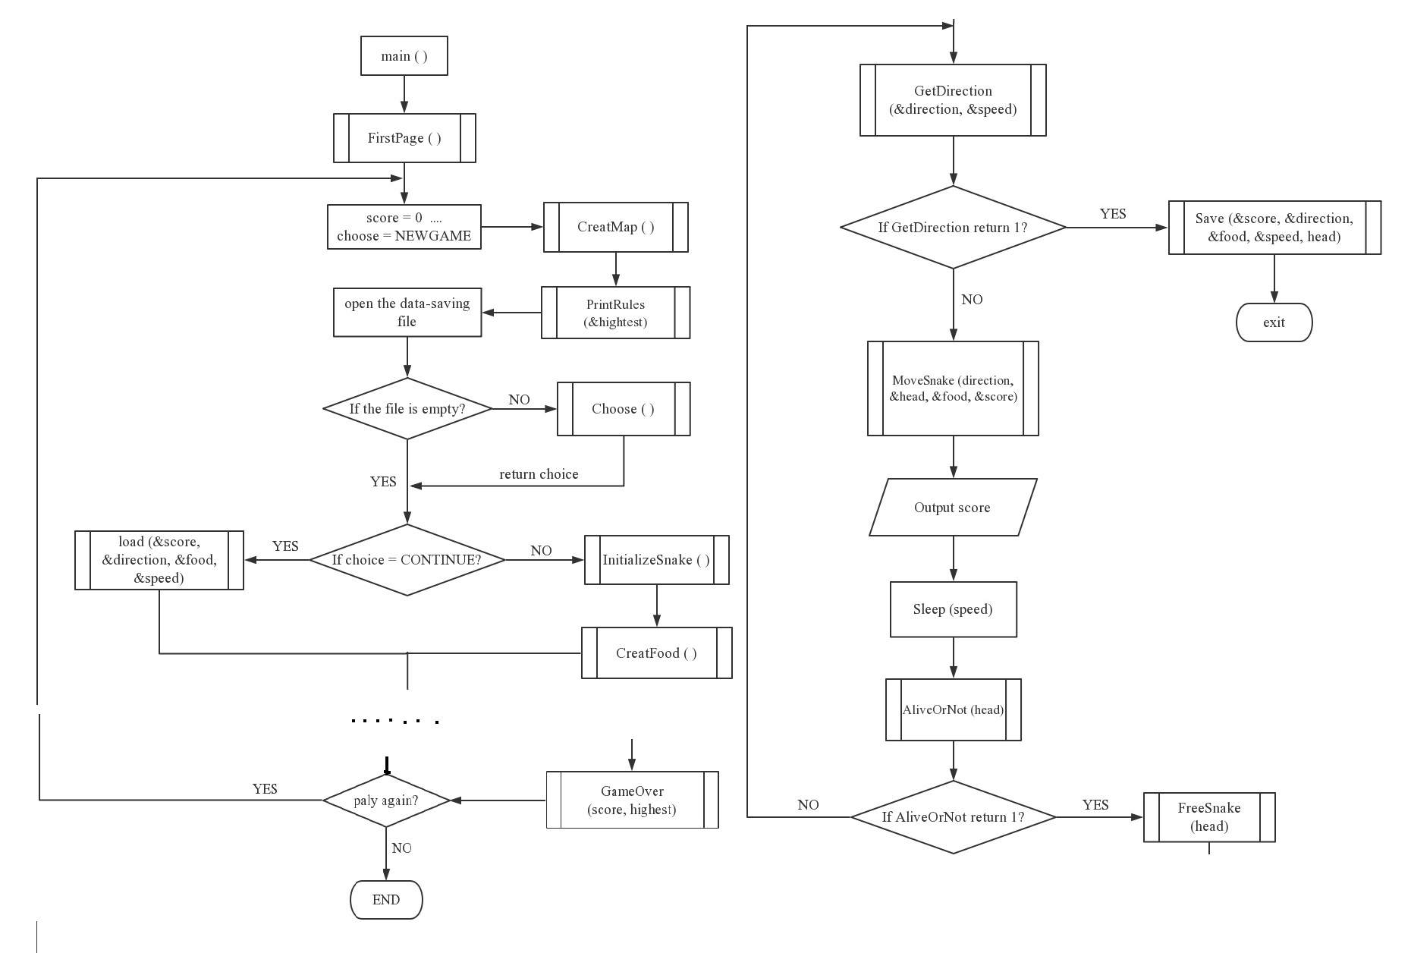
3
Design
Single Mode
1
2
3
4
5
6

Slide 13
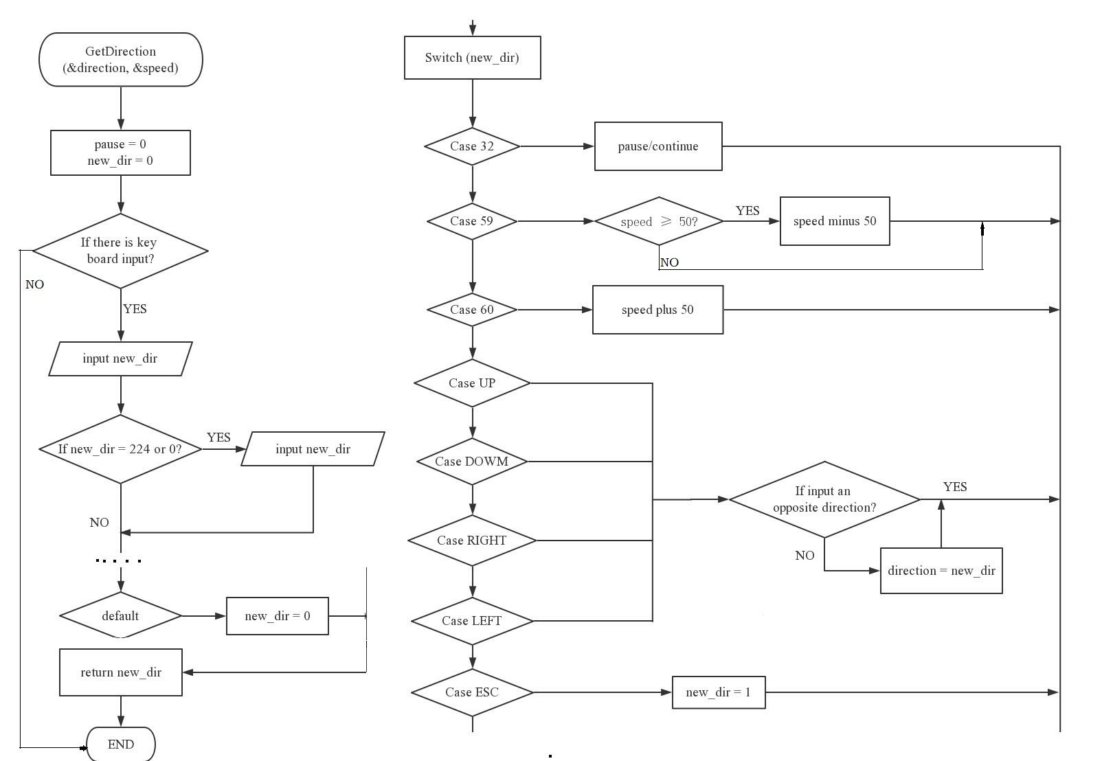
3
Design
Single Mode (basic functions)
1
2
3
4
5
6

Slide 14
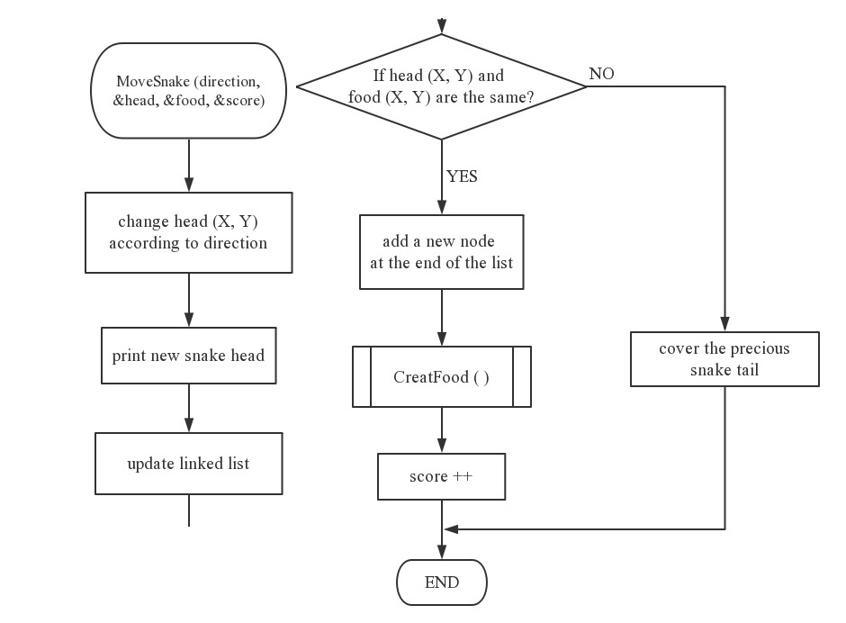
3
Design
Single Mode (basic functions)
1
2
3
4
5
6

Slide 15
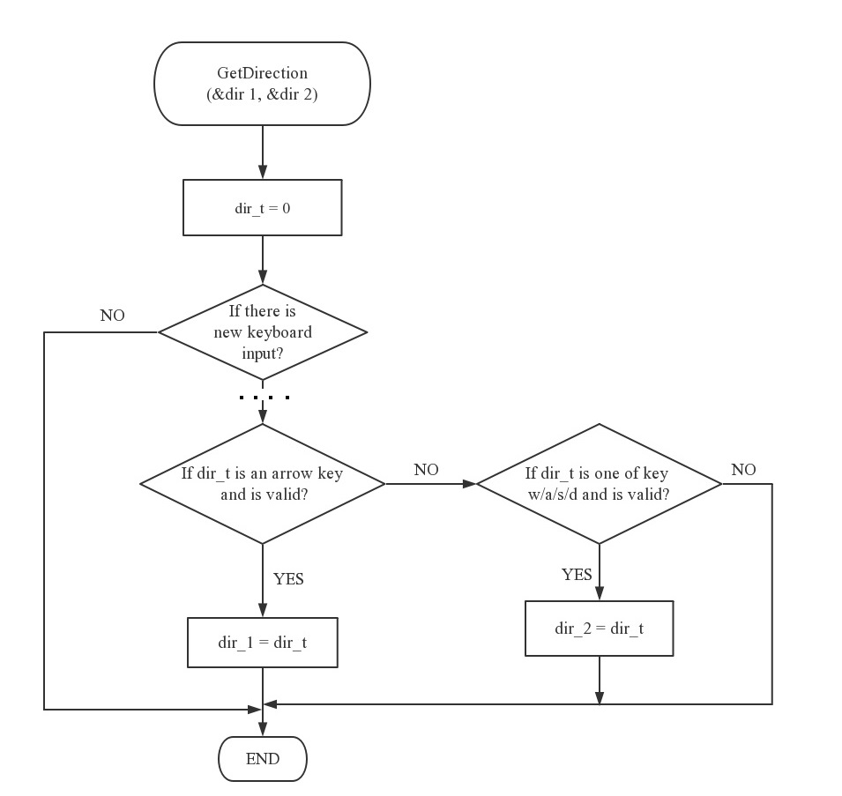
3
Design
Double Mode &Moving-obstacle Mode
1
2
3
4
5
6

Slide 16
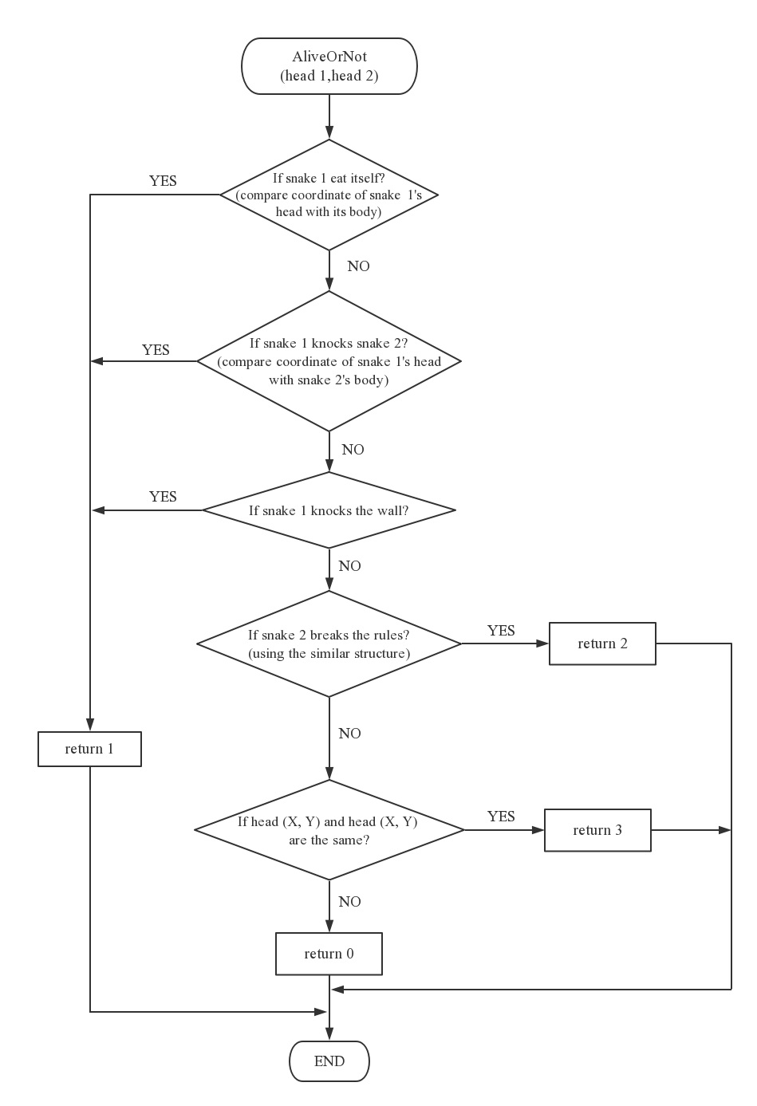
3
Design
Double Mode &Moving-obstacle Mode
1
2
3
4
5
6

Slide 17
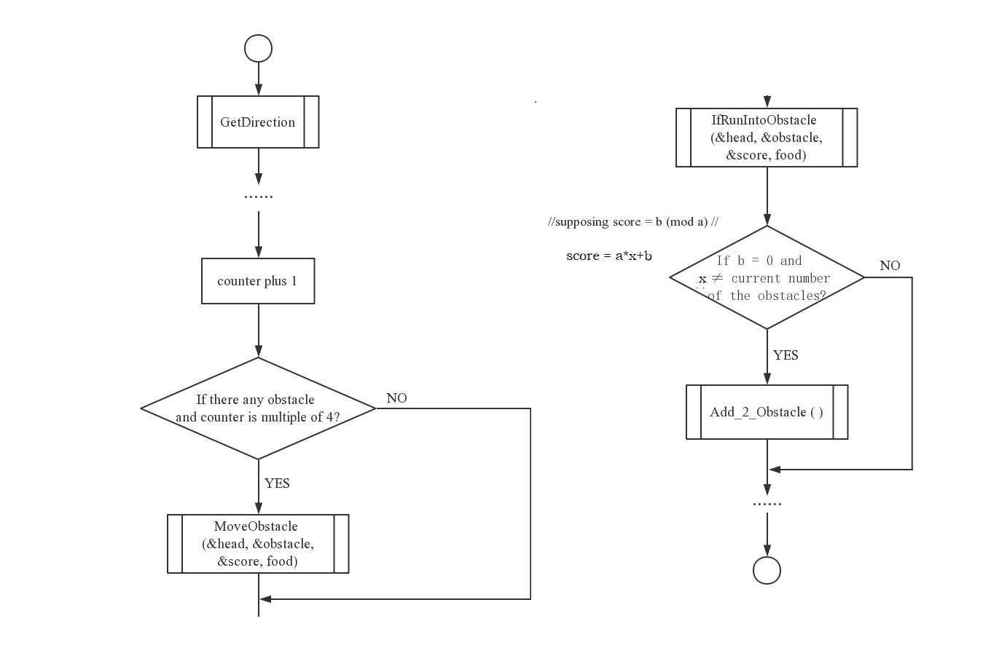
3
Design
Double Mode &Moving-obstacle Mode
1
2
3
4
5
6

Slide 18
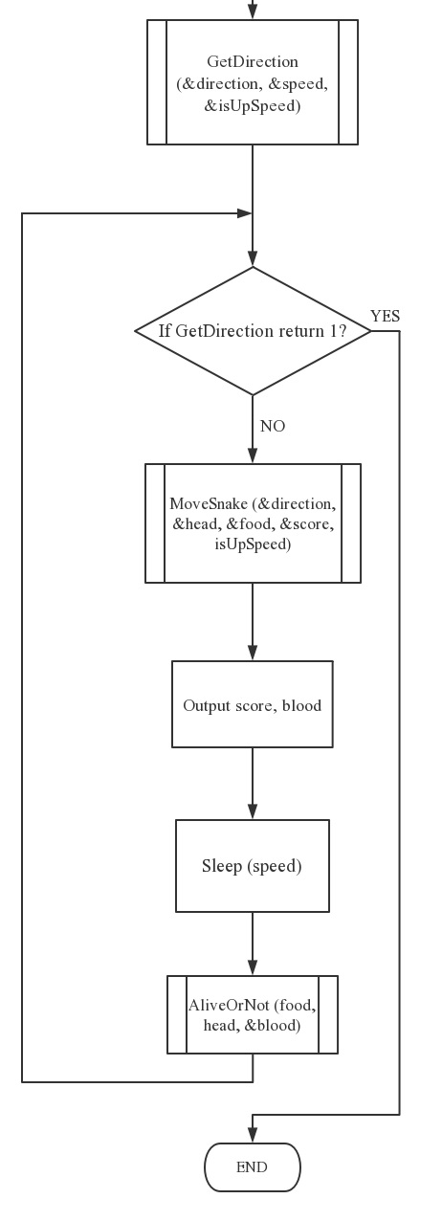
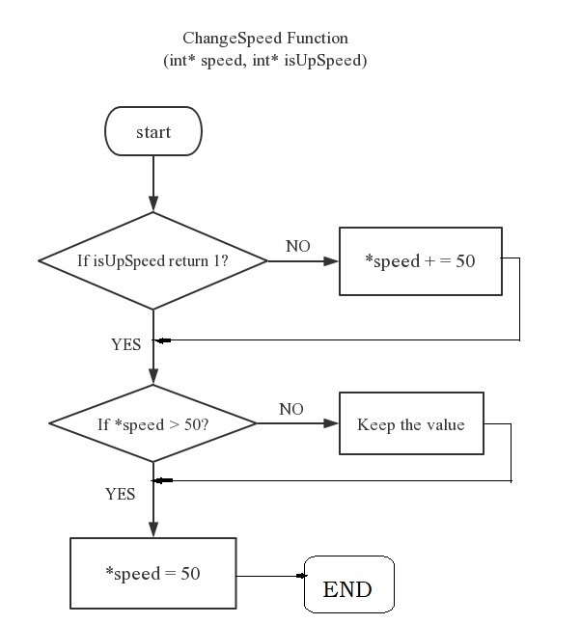
3
Design
Infinite Mode (basic or different functions)
1
2
3
4
5
6

Slide 19
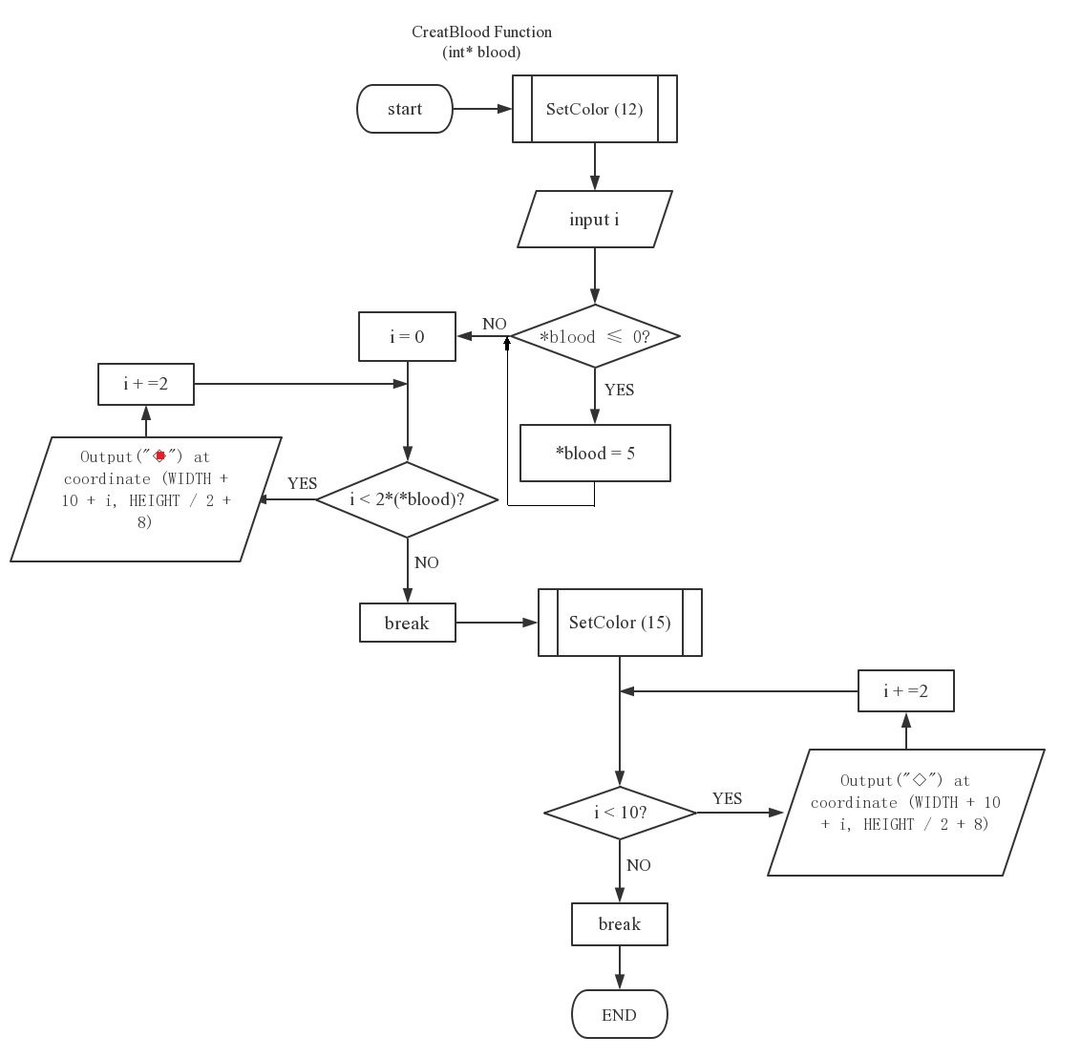
3
Design
Infinite Mode (basic or different functions)
1
2
3
4
5
6

Slide 20
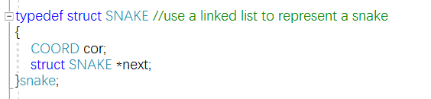
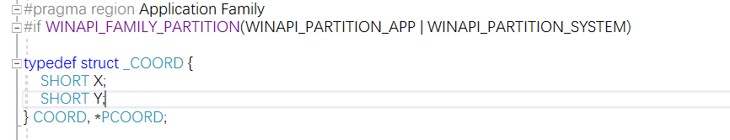
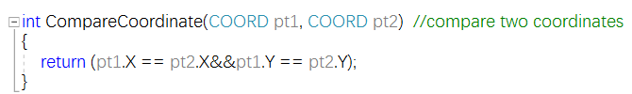
4
Implementation
1
2
3
4
5
6

Slide 21
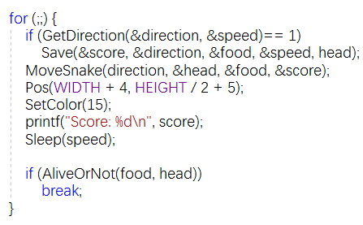
4
Implementation
1
2
3
4
5
6

Slide 22
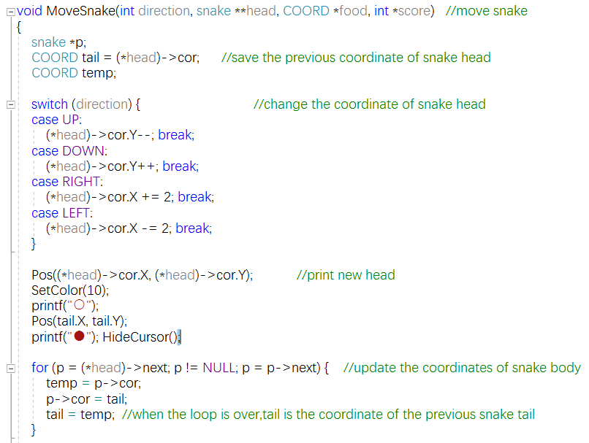
4
Implementation
1
2
3
4
5
6

Slide 23
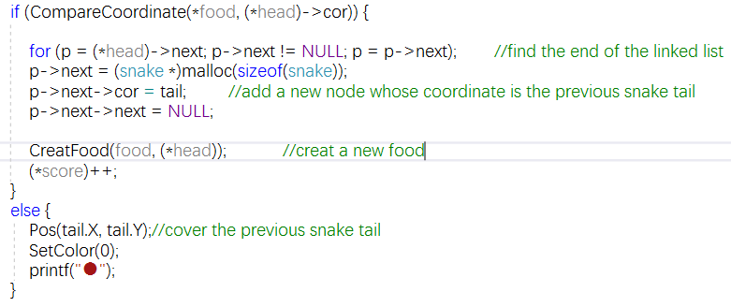
4
Implementation
1
2
3
4
5
6

Slide 24
5
Testing
1
Single Mode
2
Double Mode
3
Infinite Mode
4
Moving-obstacle Mode
1
2
3
4
5
6

Slide 25
6
Result
&Conclusions
Result:
We finished the basic functions of the game Snake using C language, and based on that, we made multiple modes: double mode, infinite mode and moving-obstacle mode, each mode has its own new functions.
Conclusion
During the process , we learn more about the superiority of the linked list. We get a deeper understanding of pointer. And we know more about Windows API function. We also learn how to improve a project and learn about the importance of the comfortable game experience.
1
2
3
4
5
6

Slide 26
THANK YOU

